Slide 1
Mapping Alcohol Availability to Youth in Tanzania, South Africa and India: Implications for structural interventions against HIV Gerry Mshana on behalf of STRIVE colleagues
Notes:
STRIVE working group to explore implications of alcohol availability and marketing in SA, Tz, India
In mixed methods study using GPS mapping and participatory action research, aimed to
Document the availability, pricing, packaging, advertising and marketing of alcohol in the three countries
Explore youth perceptions of the availability, promotion, packaging and pricing of alcohol
Explore youth drinking patterns, norms & risky behaviors including sexual violence

Slide 2
Background
Alcohol use is one of the drivers of HIV risk linked to:
Multiple partnerships (Kalichman et al 2007)
Unprotected sex and incorrect condom use (Chersich and Reese 2010)
Transactional sex (Norris et al 2009)
Alcohol use also linked to negative treatment outcomes:
Associated with poor adherence to ART (Jaquet et al 2010)
Some studies link alcohol use with disease progression

Slide 3
Objectives
Document the availability, pricing, packaging, advertising and marketing of alcohol
Explore youth perceptions of the availability, promotion, packaging and pricing of alcohol
Explore youth drinking patterns, norms & risky behaviors including sexual violence
Research sites
Mwanza & Kilimanjaro regions (Tanzania)
Gauteng and Mpumalanga provinces (South Africa)
Mumbai (India)

Slide 4
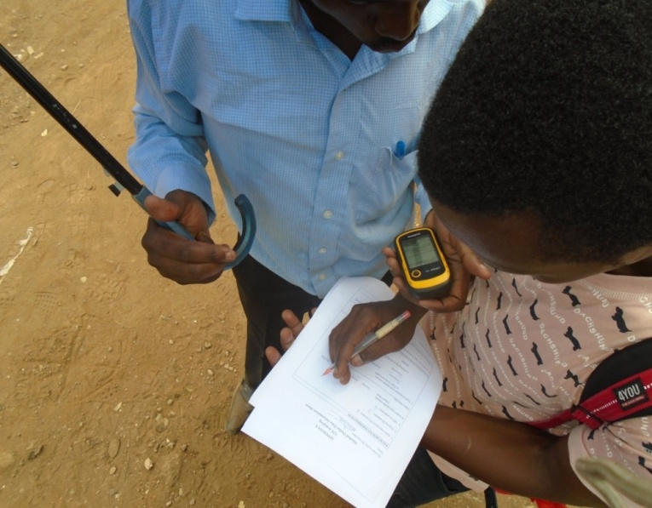
Methods
Mapping
Photovoice
GIS mapping of alcohol outlets near education institutions
Walk along each street & record point at every school/college and alcohol outlet using GPS device
Record observable information of outlets & photograph adverts
Purposive sample: 18-24 years
Given camera & to photograph interactions of youth with alcohol in their localities & caption them
Confidentiality & photo acting
12 photo voice groups ( 4 in each country)
Each taken through a series of discussions about photos & captions
Atlas ti & Nvivo software used for analysis

Slide 5
Findings
Alcohol outlets & adverts in Mwanza, Tanzania
Notes:
Each school within a 500m radius of between 7-30 alcohol outlets

Slide 6
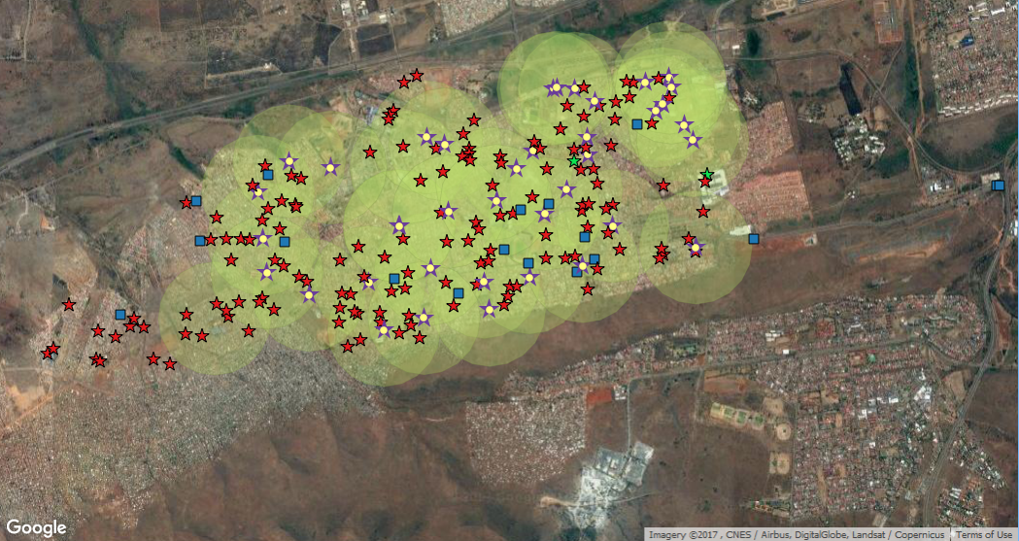
Alcohol outlets & adverts in urban South Africa 147 alcohol outlets vs 36 schools
Notes:
8-10 outlets per main street
15 standalone billboards and posters on main roads – brands changed twice to thrice within the study period
100% - All schools had at least 1 outlet within a 500m radius.
Law says outlets should be 500m away from school & places of worship (10m)
Lack of policing ; Lack of compliance; Liquor board continues to issue licenses
76% = 112 outlets had advertising outside of the venue – poster/ painting of brand or pricing
MRC survey findings:
TV movies 91%; Signs at shops 87%; Poster and billboards 81%; Special price offers 77%
Sports sponsorships 70%; Celebrities 63%; Music events sponsorships 57%

Slide 7
Alcohol outlets in Mumbai
Notes:
There is a consistent accessibility of alcohol shops from colleges in all three regions within a distance of 100 m.
In case of five colleges, liquor availability is within 50m, even fewer meters in case of some.
The least distance in this case found to be 0.4 m, meaning a liquor facility just outside the college.
Maximum density of alcohol outlets in South Mumbai that comprised of “resto-bars” and bars; whereas East Mumbai the alcohol outlers were relatively away from educational insitutions and mainly comprised of liquor shops

Slide 8
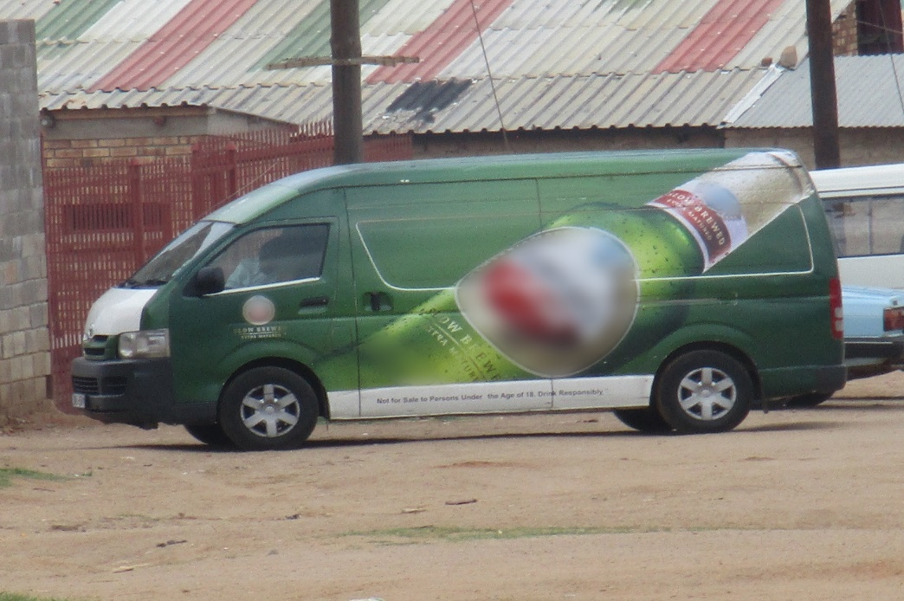
Messages in advertisements
Alcohol advertising is attractive to youth
Promotions encourage ↑ drinking:
1. Competitions
2. Celebrity events at taverns
3. Cheap prices and/ or discounts
happy hour’, ‘ladies’ night' and‘ buy 1 get 1 free‘
Male: They say Ladies’ Night because ladies get their alcohol for free... the whole community goes! even if you are 14 years, as long as you're a girl you get in and get your free drink (South African Site)
Just by looking at the image of this alcohol, you feel like trying it! © Paballo/ 31-10-15/ South African Site)

Slide 9
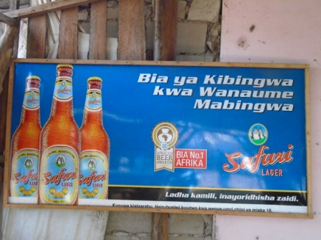
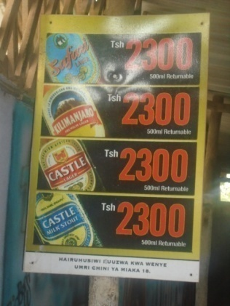
Emphasis on affordability & masculinity
‘a champion beer for champion men’
Adverts use gender norms to appeal to male drinkers (Tanzanian Site)
Emphasis on different brands and affordable prices of alcohol (Tanzanian Site)

Slide 10
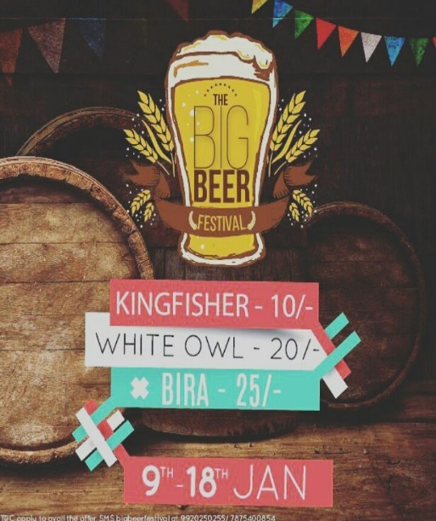
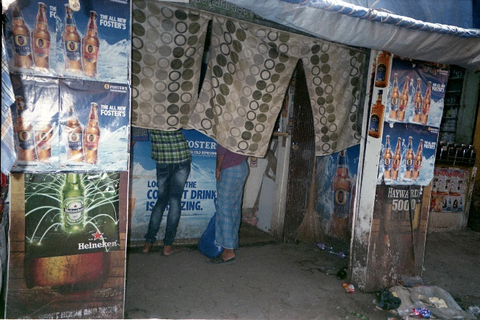
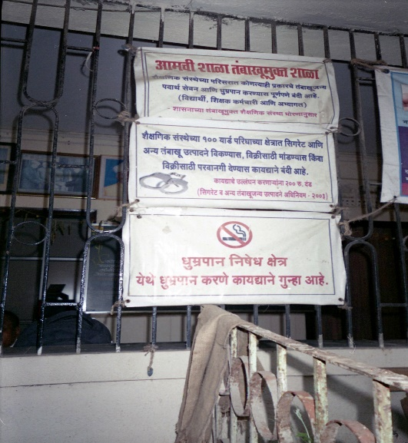
Advertisement in India
Mostly done online
Although illegal, some alcohol adverts documented near education institutions in India
Notes:
While aggressive marketing to youth was well documented by youth from middle class families, the messages were around life-style, swanky drinking venues and packaging which made easy to fit a bottle in your scooter
Whereas youth who came from marginalised communities, saw alcohol everywhere around them without any special offers. This group noticed how close alcohol was being advertised near schools and coaching classes within their communities.

Slide 11
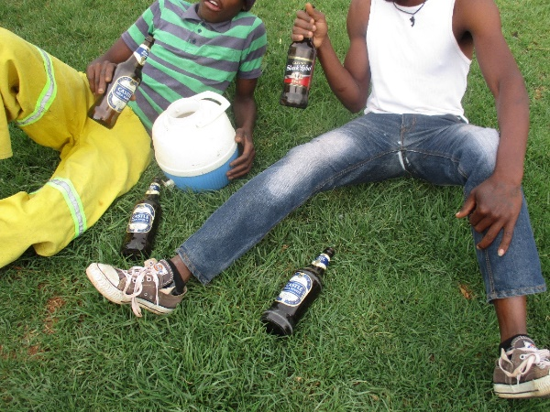
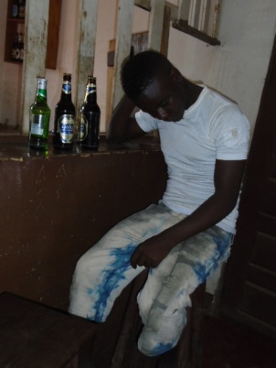
Availability leads to youth alcohol ‘binging’
There is some madness in how we drink [alcohol]. The thing is we buy 5litre and you want to finish it in one night. You want to drink all of it… they drink to get drunk! …They would even tell you, “Why am I drinking alcohol if am not going to get drunk? (South African site)
This photo shows a young man who has drank a lot of alcohol and is highly intoxicated…you can see he already regrets wasting his money. A lot of young people spend much more than what they earn. (Tanzanian site)

Slide 12
Sexual risk, violence & transactional sex
Youth relate alcohol with sexual violence
Exchanging alcohol for sex often with older males acceptable
Unprotected, unplanned and regretted sex
Like you get used to drinking … Friday, Saturday and Sunday you are on it [All: Yah] you don’t want to be home but just want to go out… because you can’t afford to buy alcohol every weekend, these are some of the things that make people to go to Sugar Daddys … then… they want you to sleep with them…

Slide 13
Policy recommendations
Need strong alcohol policies in developing countries to protect youth & other vulnerable groups
Create safe spaces e.g. schools & playing grounds
Such policies must regulate alcohol availability and advertisement targeting youth
Use powerful evidence display tools such as mapping to engage policy makers in implementation of such policies

Slide 14
Implications for HIV programmes
Interventions need to address alcohol use among youth to reduce risk of HIV & reduce barriers to access to effective HIV prevention and treatment options
Such interventions need to address:
Binge drinking
Transactional sex
Unsafe sex and casual sex that is later regretted
Sexual violence

Slide 15
Acknowledgements
STRIVE Alcohol Working group
Study participants in all countries
Central and local government officials in the study sites
DFID, UK (funder)
Katherine Fritz: International Centre for Research on Women (ICRW), Washington DC, USA
Lebohang Letsela &
Renay Weiner : Soul City Institute for Social Justice, Johannesburg, South Africa
Haika Osaki National Institute for Medical Research (NIMR), Mwanza, Tanzania
Priti Prabhughate International Centre for Research on Women (ICRW), Mumbai, India
www.strive.lshtm.ac.uk

